Slide 1

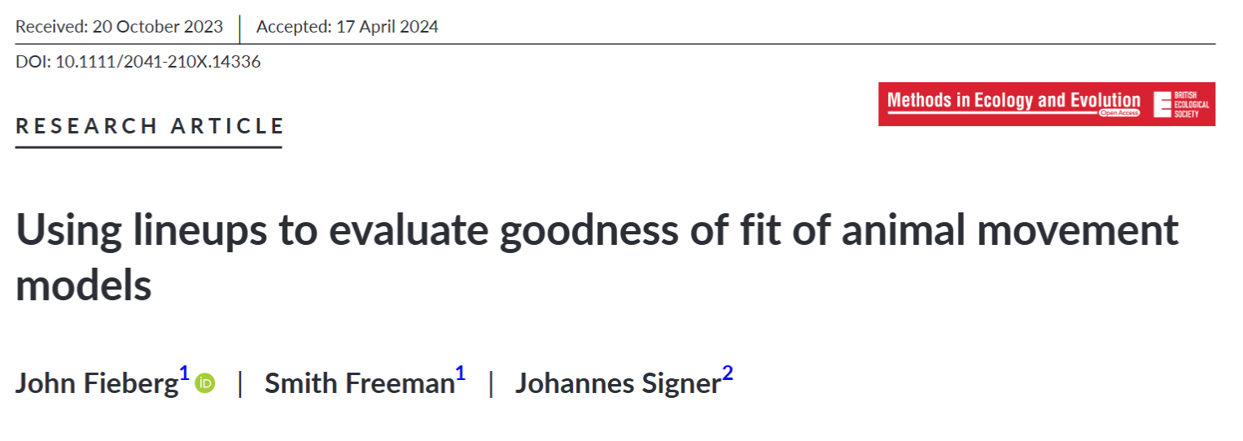
Evaluating Animal Movement Models

Slide 2
Model Evaluation
Discrimination: how well does the model discriminate between ‘good’ and ‘bad’ habitat?
Given two different locations, one close to water and one far from water, can the model identify which location is most likely to be used?
Often measured using something like AUC (area under the receiver operating curve)
Calibration: how well does the model describe the probability (or relative probability) of using different areas?
If the model predicts sites within 1 km of water are twice as likely to be used as sites 10km from water, does this happen?
More broadly, we might want to evaluate features/assumptions of our model (e.g., are step lengths and turn angles independent? Do turn angles follow a von Mises distribution?)
.

Slide 3
Model Evaluation
Compare observations with predictions from our fitted model
Spatial distribution
Distribution of environmental covariates at used locations
Distribution of step-lengths, turn angles, etc
Best to use out-of-sample data (data not used to fit the model)
Data splitting, cross-validation, bootstrapping
Ideally, treat animals or study sites as independent replicates
Incorporate parameter uncertainty when possible
Bootstrapping, posterior predictive distributions
Sample parameters from a multivariate normal distribution with estimated variance/covariance matrix

Slide 4
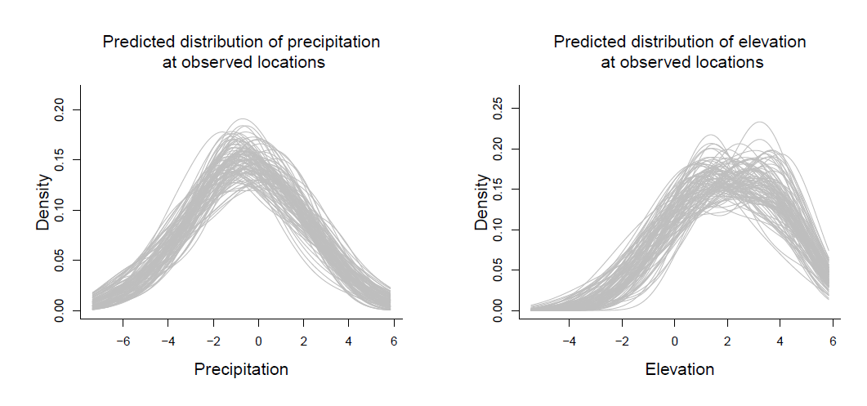
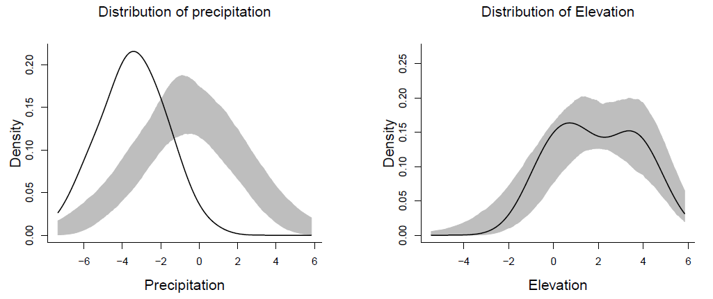
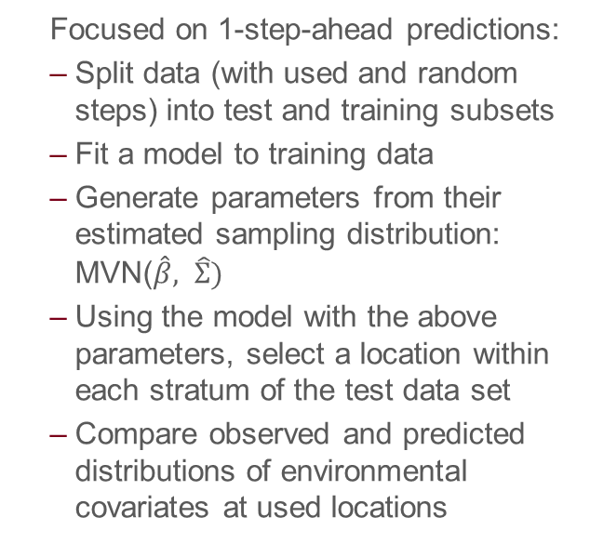
UHCplots (Ecography paper)
Focused on 1-step-ahead predictions:
Split data (with used and random steps) into test and training subsets
Fit a model to training data
Generate parameters from their estimated sampling distribution: MVN($\hat{β}, \hat{Σ})$
Using the model with the above parameters, select a location within each stratum of the test data set
Compare observed and predicted distributions of environmental covariates at used locations

Slide 5
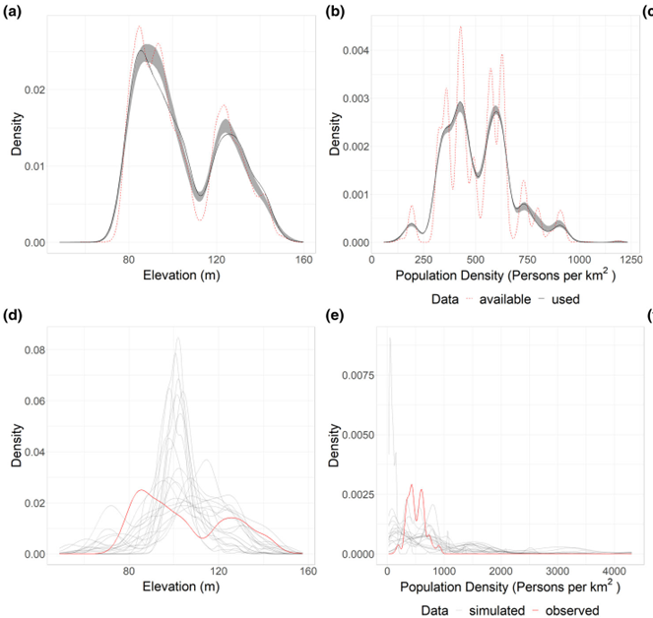
Limitations
Available locations were sampled using the tentative (rather than updated) movement parameters
Goodness-of-fit testing requires correcting for multiple testing (or, a summary statistic for each predicted distribution)
Not much spatial heterogeneity at the level of the movement step
Simulated trajectories show more variation but are more computationally intensive to generate!

Slide 6


Lineup Protocol
Simulate n data sets from the fitted model.
Combine each of the data sets with the observed data.
Create a random index for the location of the observed data in a multi-panel plot.
See if the observed data stand out in some way.

Slide 7
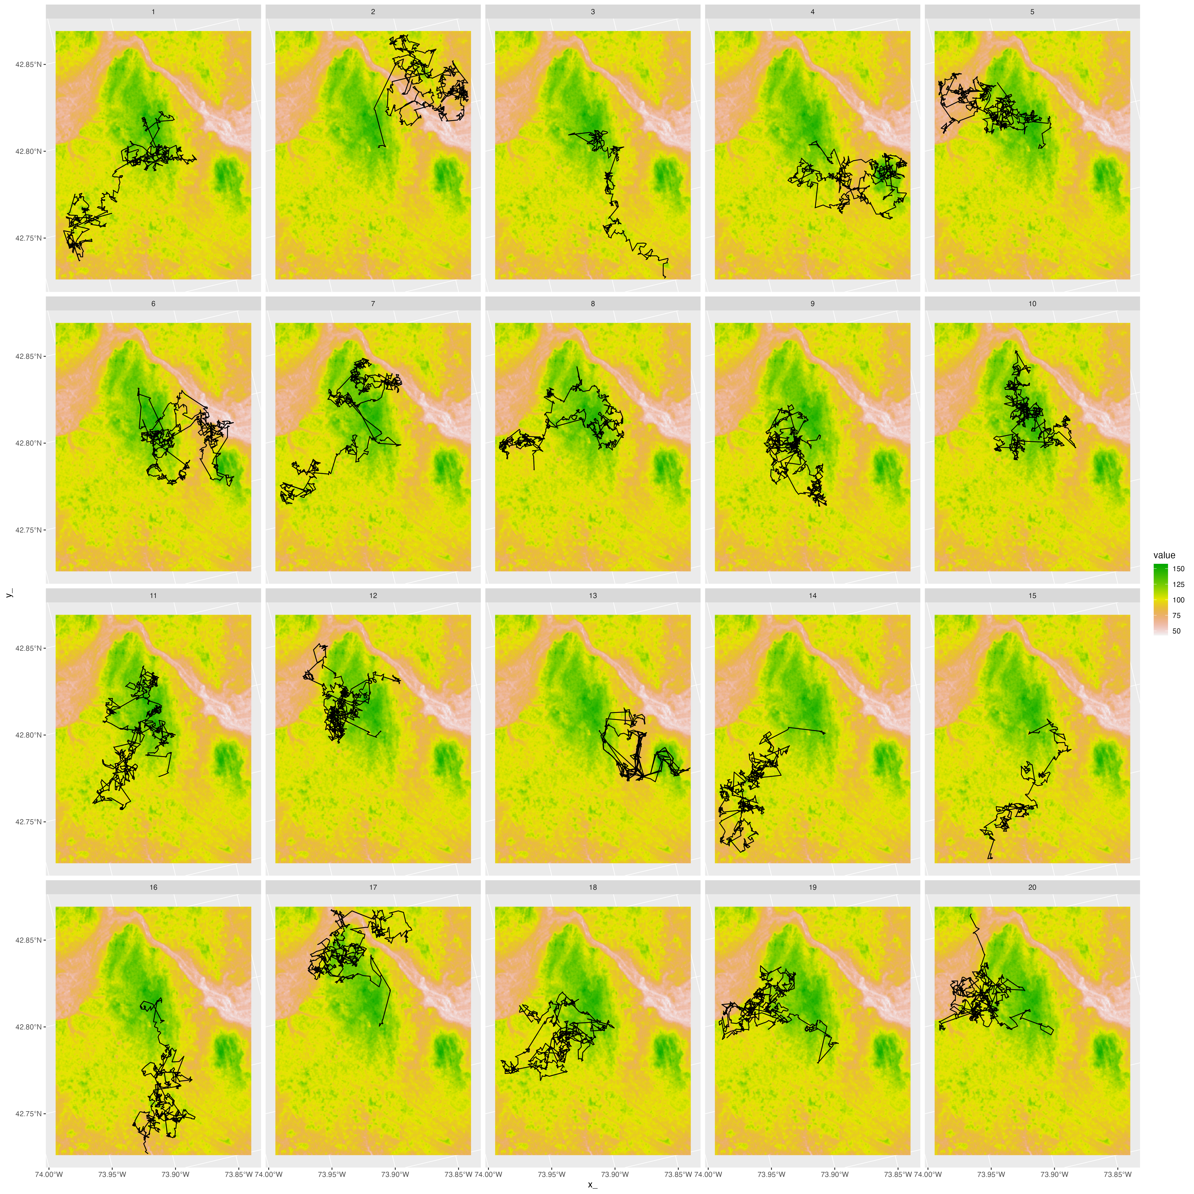
Lineup Goodness-of-fit test
H₀: The observed data are consistent with the fitted model.
H_{A}: The observed data are NOT consistent with the fitted model.
Test statistic = a plot of the real data!
Sampling distribution | H₀ = plots using simulated trajectories from the fitted (i.e., null) model.

Slide 8
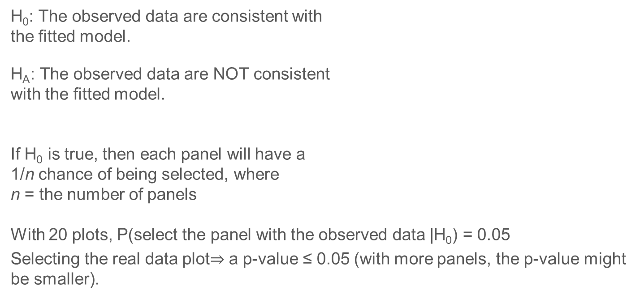
Lineup Goodness-of-fit test
H₀: The observed data are consistent with the fitted model.
H_{A}: The observed data are NOT consistent with the fitted model.
If H₀ is true, then each panel will have a 1/n chance of being selected, where n = the number of panels
With 20 plots, P(select the panel with the observed data |H₀) = 0.05
Selecting the real data plot$⇒$ a p-value ≤ 0.05 (with more panels, the p-value might be smaller).

Slide 9
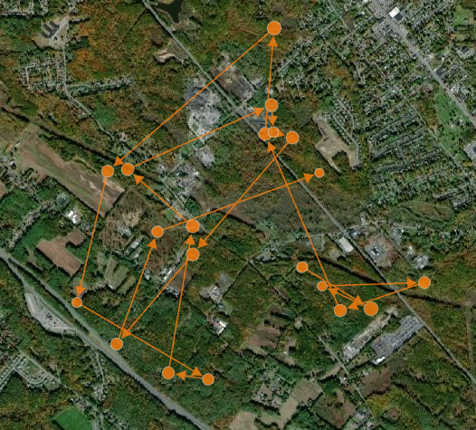
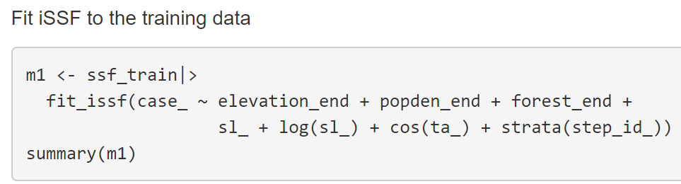
ISSA
Integrated step-selection analysis of fisher data (Lapoint et al. 2013).
Predictors:
Landcover class (forest or not)
Human Population Density
Elevation
LaPoint, S., Gallery, P., Wikelski, M., & Kays, R. (2013b). Data from: Animal behavior, cost- based corridor models, and real corridors. Movebank Data Repository. Retrieved from https://doi. org/10.5441/001/1.2tp2j43g

Slide 10
ISSA

Slide 11
ISSA

Slide 12
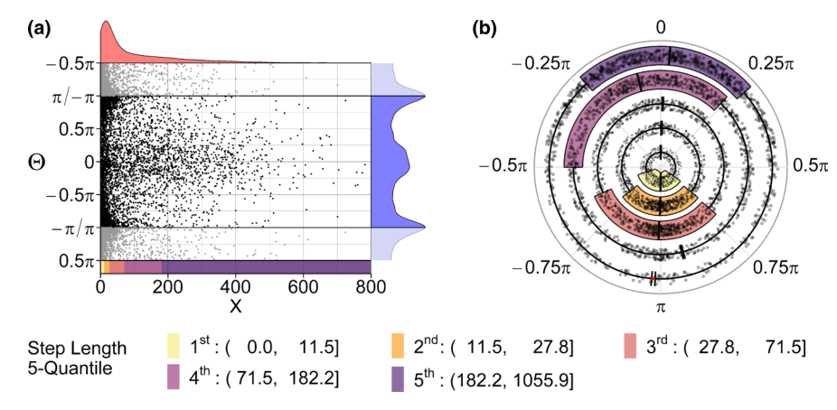
Correlation between step-lengths and turn angles
Hodel, F. H., & Fieberg, J. R. (2022). Circular–linear copulae for animal movement data. Methods in Ecology and Evolution, 13(5), 1001-1013.

Slide 13
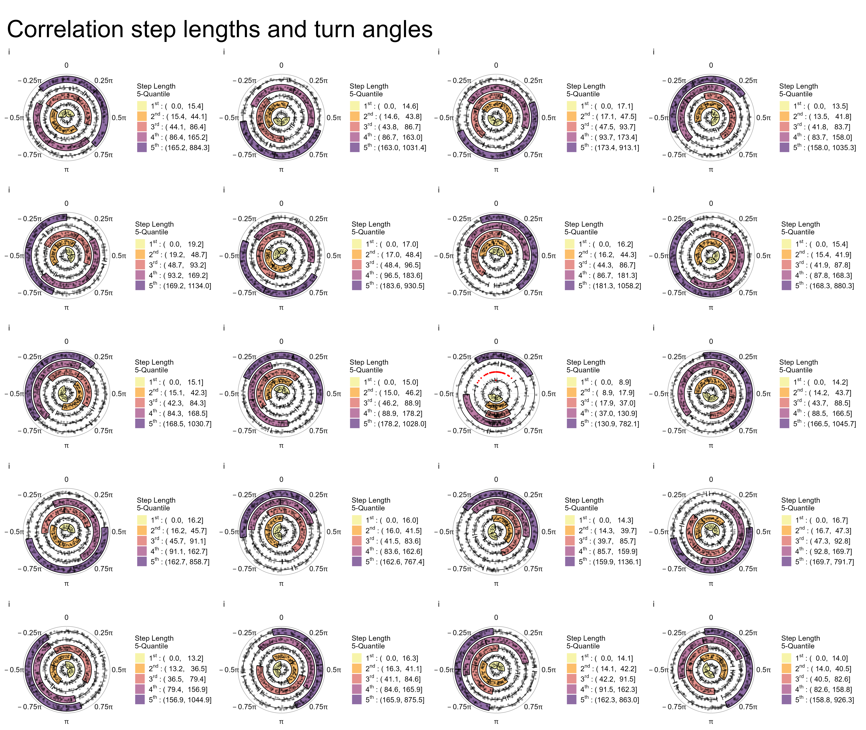

Slide 14
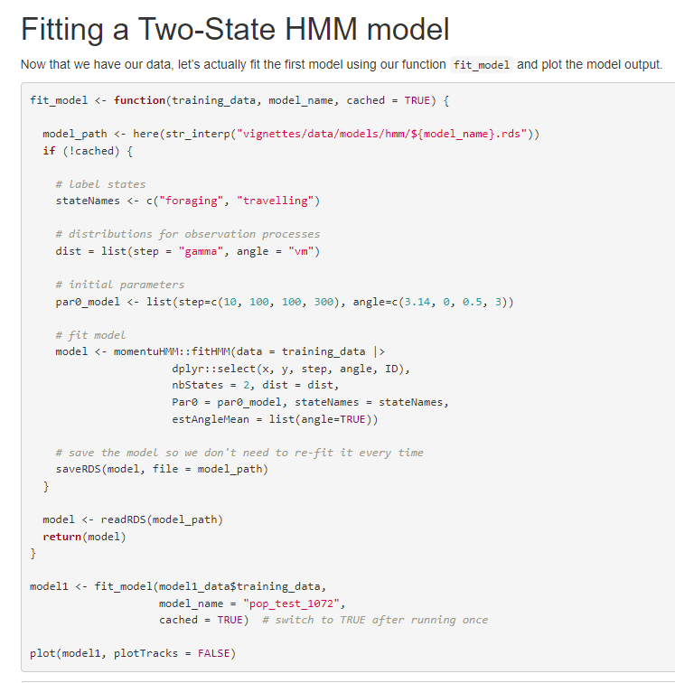
Hidden Markov Model
Two states (foraging and traveling)
State-dependent step-length and turn-angle distributions:
Step length ~ Gamma
Turn Angle ~ von Mises

Slide 15
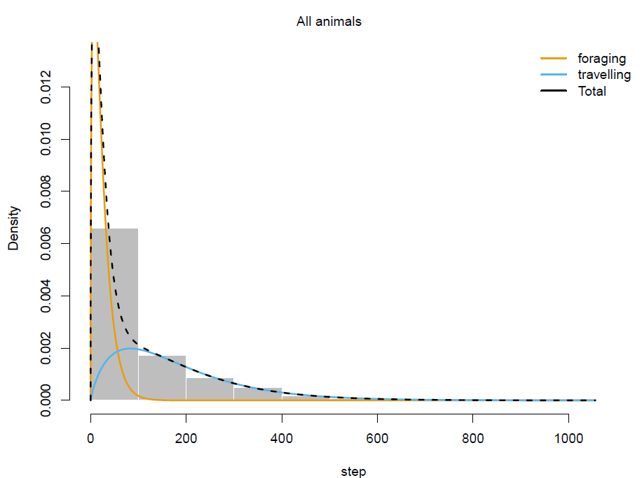
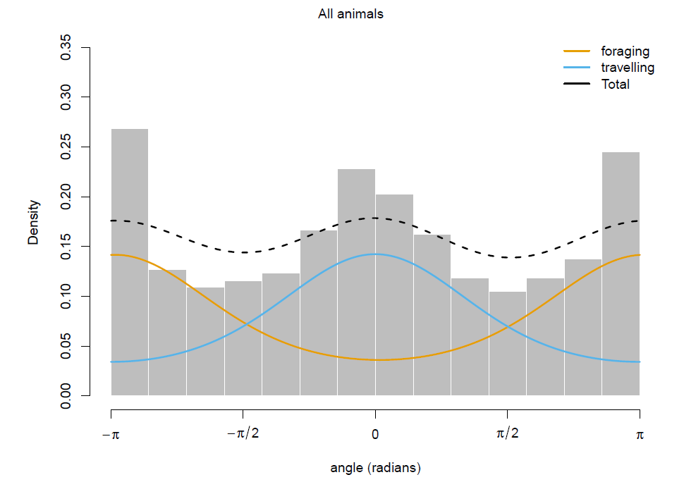
Hidden Markov Models (HMM)

Slide 16
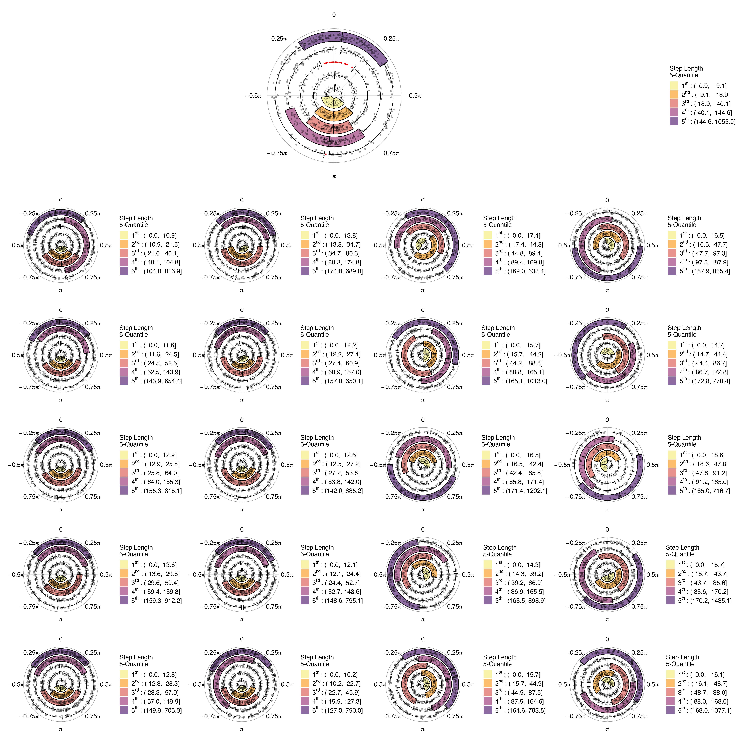
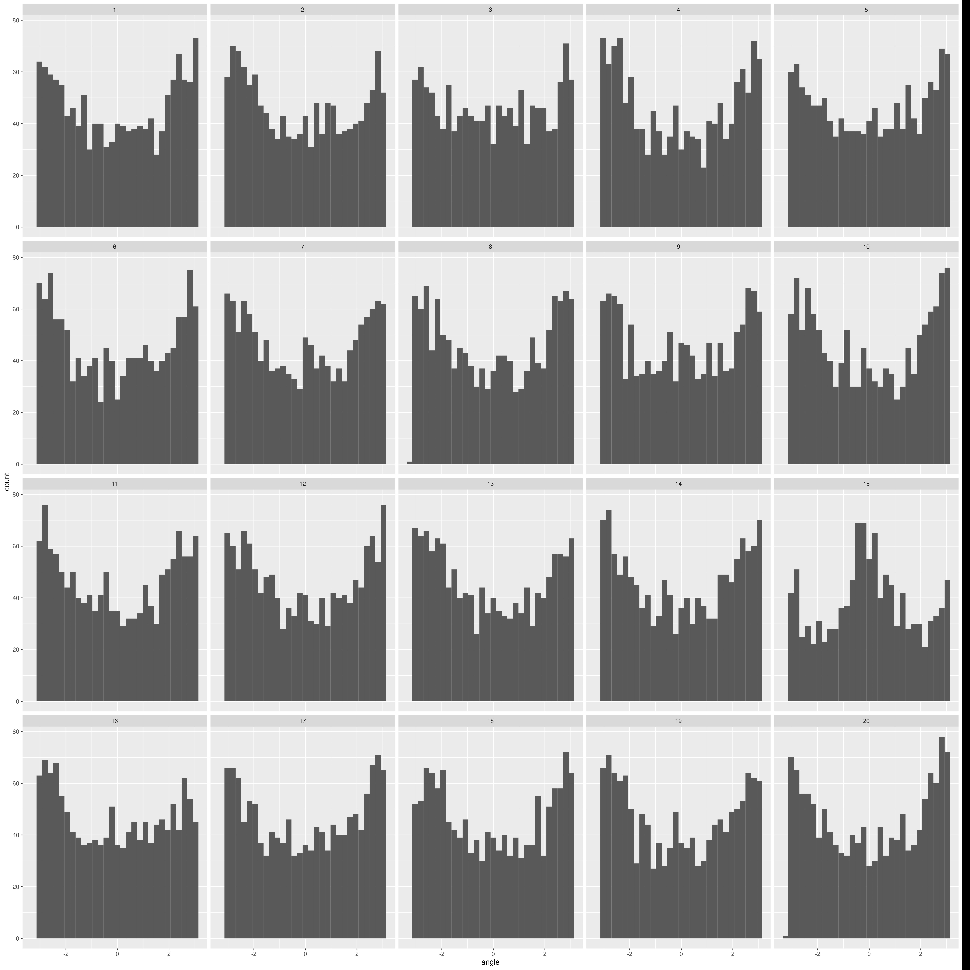
HMM
HMM
ISSA

Slide 17
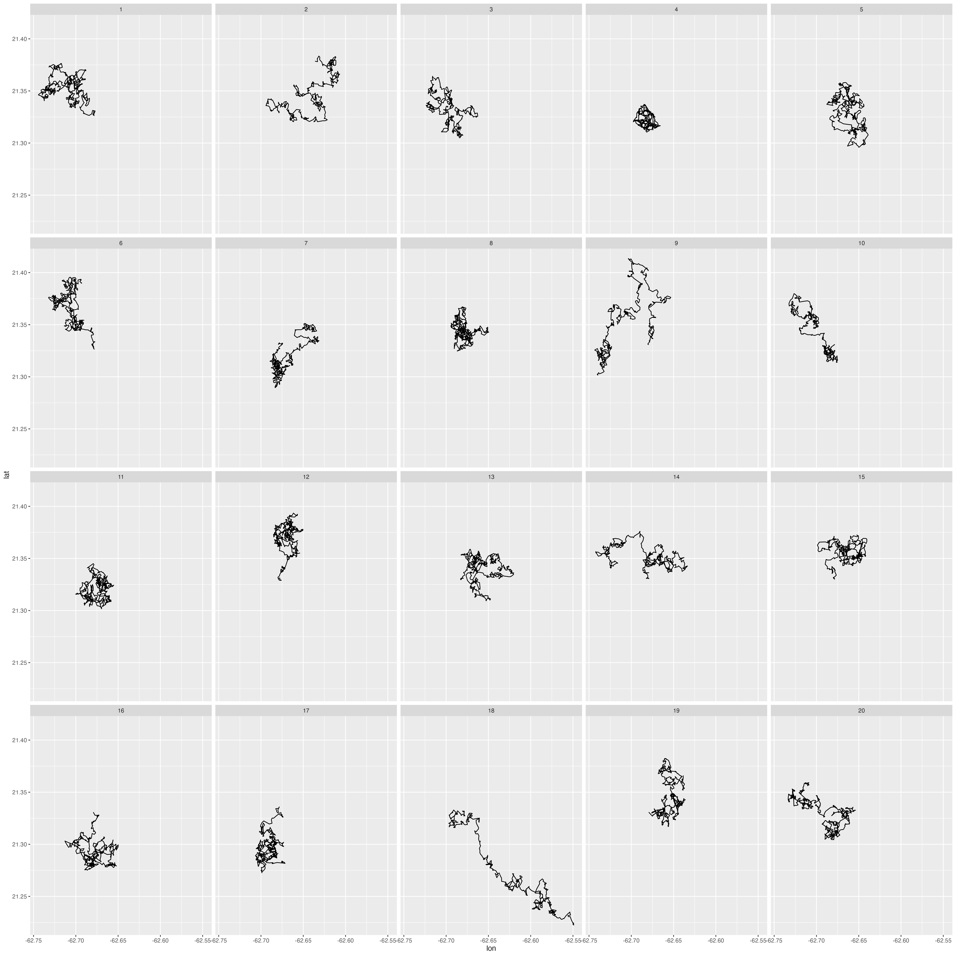
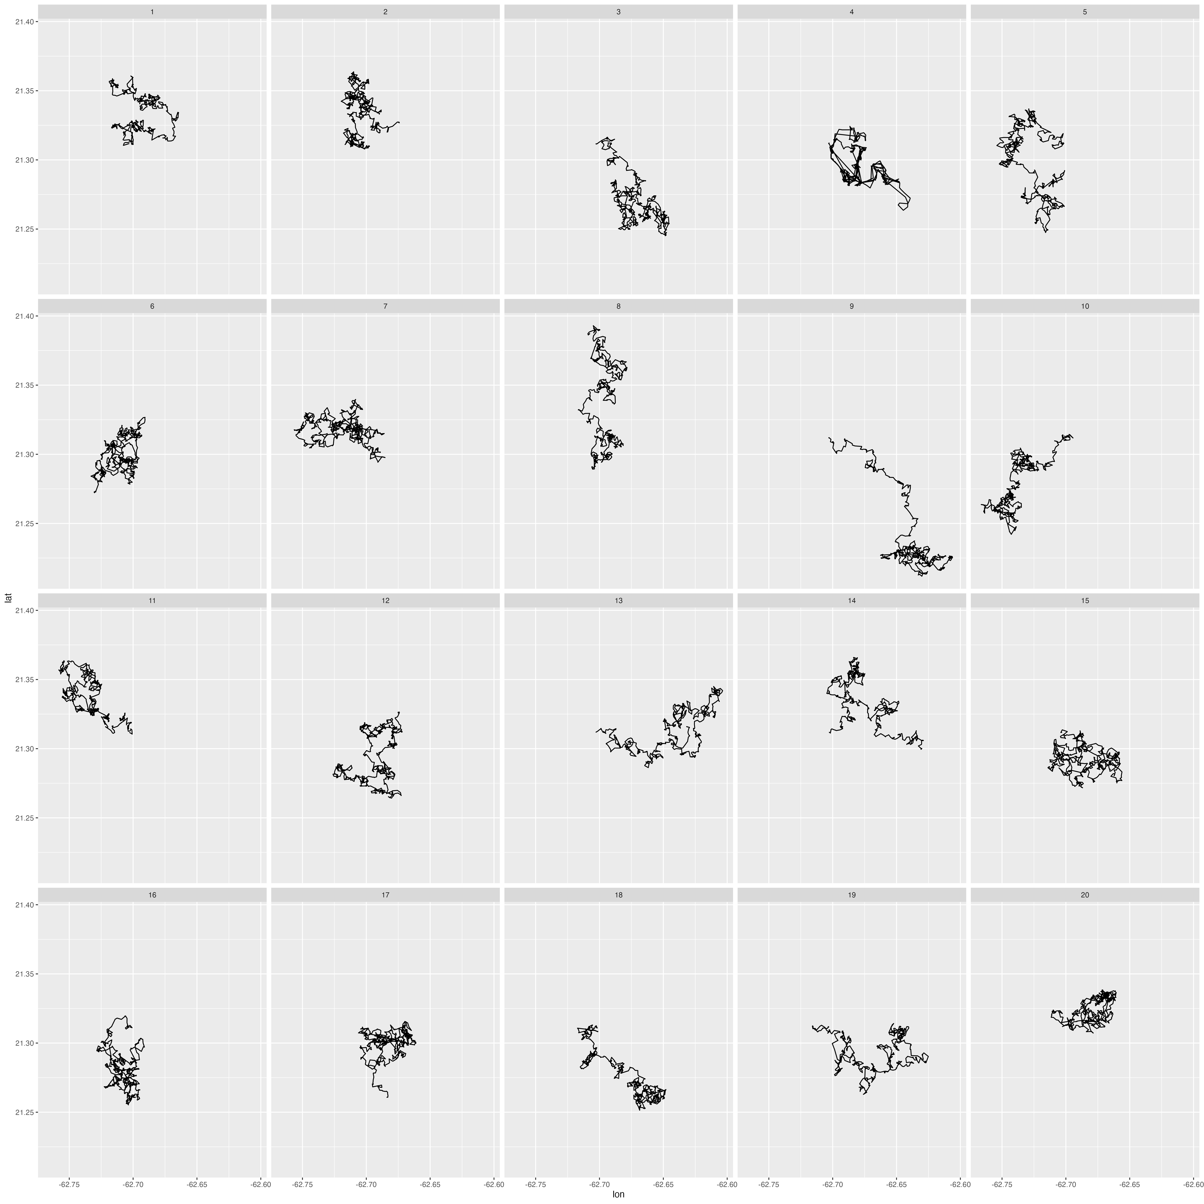
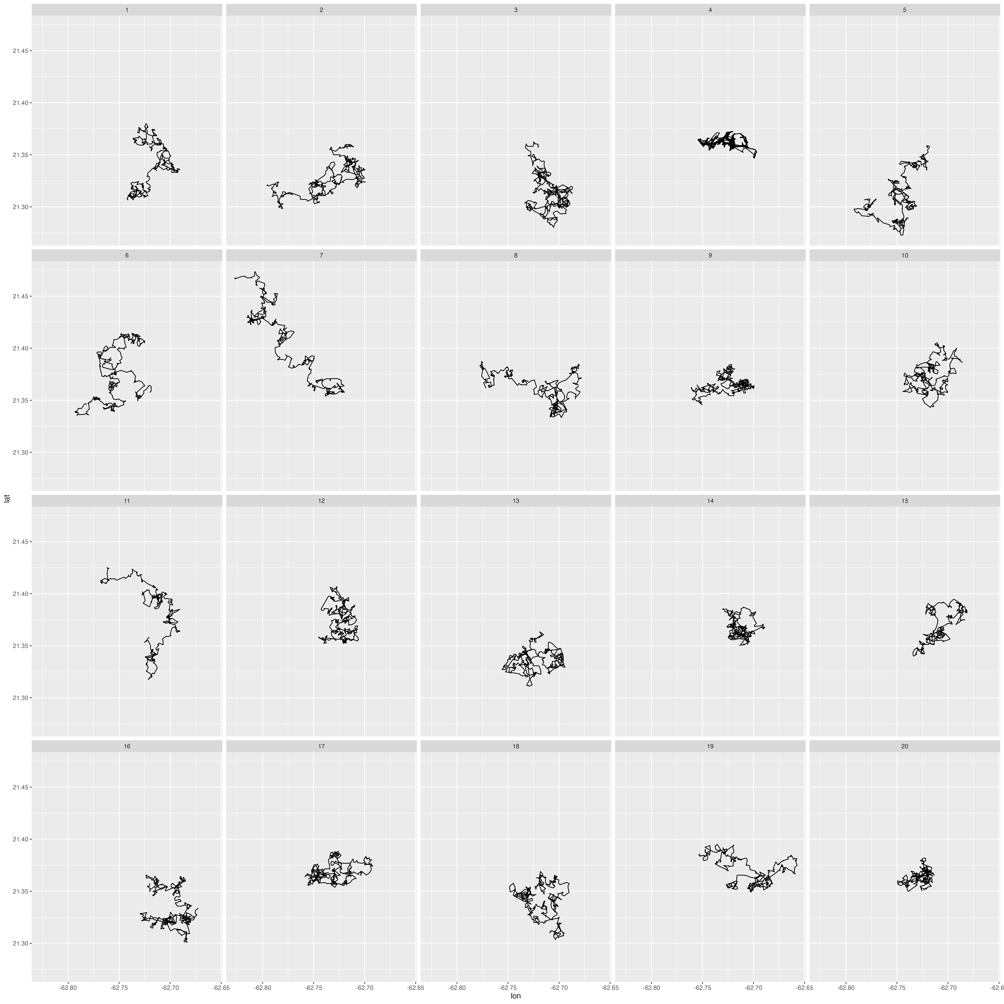
Testing With Multiple Lineups/Observers
K individual observers (each with a unique lineup)
X = number of times the observed data plot is selected
Under H₀: X ~ Binomial(K, p); p = 1/number of plots
P-value = Prob(X ≥ x)
References
Majumder, M., Hofmann, H., & Cook, D. (2013). Validation of visual statistical inference, applied to linear models. Journal of the American Statistical Association, 108(503), 942-956.
VanderPlas, S., Röttger, C., Cook, D., & Hofmann, H. (2021). Statistical significance calculations for scenarios in visual inference. Stat, 10(1), e337.
Wickham, H., Cook, D., Hofmann, H., & Buja, A. (2010). Graphical inference for infovis. IEEE Transactions on Visualization and Computer Graphics, 16(6), 973-979.

Slide 18
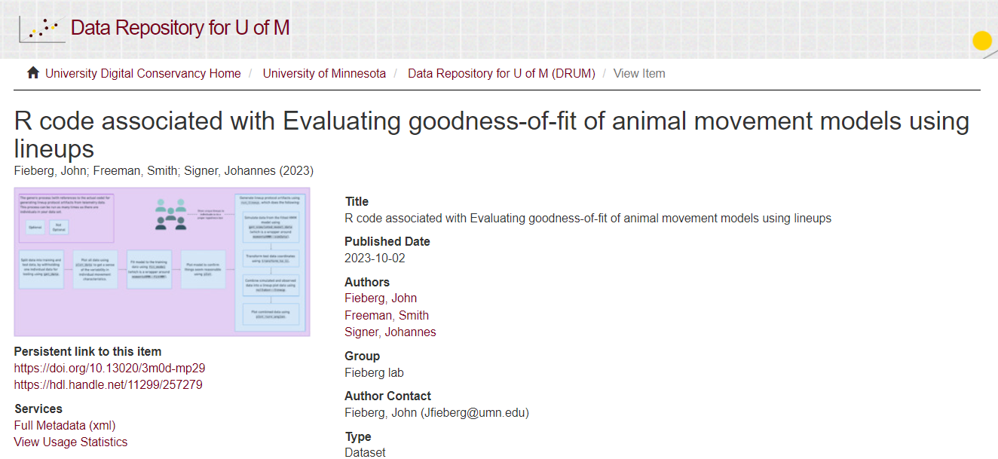

https://conservancy.umn.edu/handle/11299/257279

Slide 20
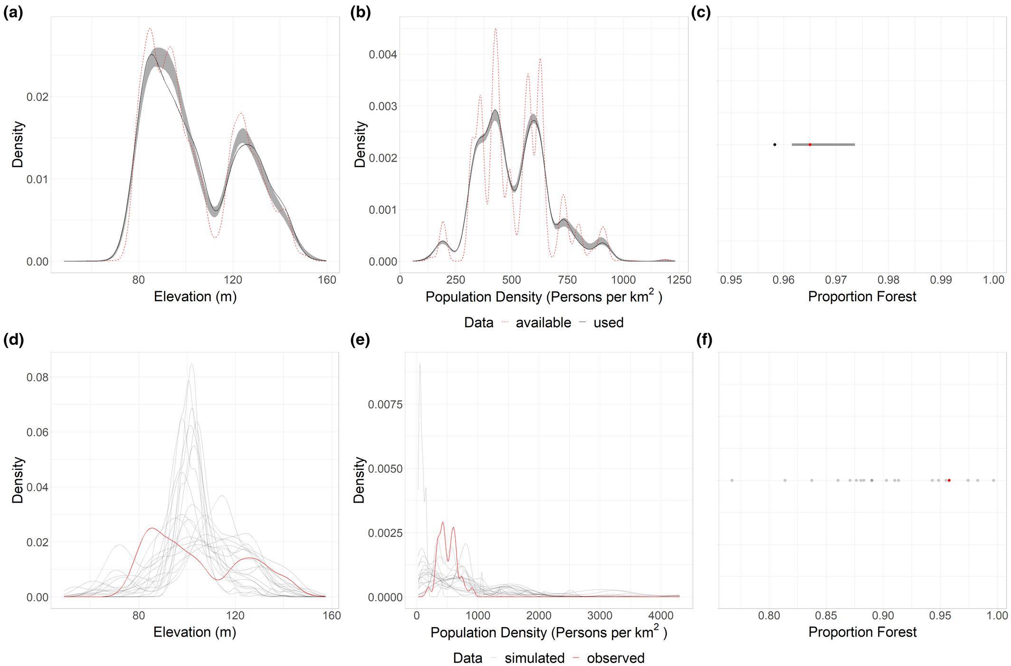
Summarize simulated trajectories
Used-habitat calibration plots (top row)
Trajectory summaries (bottom rown)
Training data (2 fisher)
Test data (1 held out fisher)

